Slide 1

Data Management with AI and Python
Use ChatGPT and Python to enhance your ability to manipulate flood modeling and mapping data.
ASFPM 2025 Conference

Slide 2
ChatGPT Overview
AI Language Model by OpenAI: Designed to assist with a variety of tasks through text-based conversations.
GPT (Generative Pre-trained Transformer): Utilizes advanced machine learning models to understand and generate human-like text.
Natural Language Understanding: Interprets and generates human-like text in real-time.
User-friendly and Accessible: Easy to use across multiple platforms.
Focused on Ethics: Prioritizes privacy, safety, and ethical AI use.

Slide 3
ChatGPT 4.0 Applications
Writing assistance (emails, reports, creative writing)
Code generation and debugging
Data analysis and visualization
Knowledge queries and problem-solving
ChatGPT models are periodically updated to improve performance and adapt to new information.

Slide 4
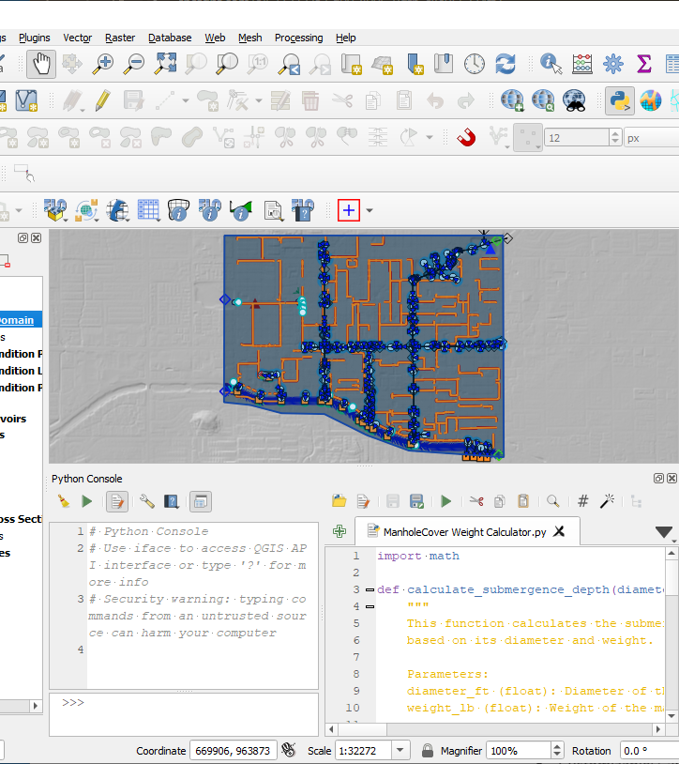
Python Script
Simplify data processing
Efficient for repetitive tasks
ChatGPT makes tools accessible

Slide 5
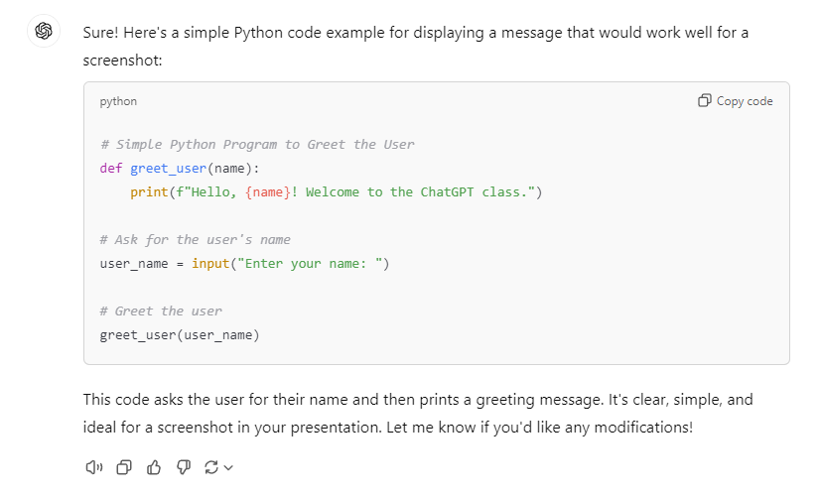
Add Python to your toolbox
GPT
Python
GIS

Slide 6

Python Pros
Open source
No complex compilers
Large community
Excellent documentation
Python Cons
Version control
Cranky path issues
Debugging

Slide 7


Jupyter Notebook
What is Jupyter?
An open-source tool for interactive computing.
Allows you to create and share documents that contain live code, equations.
Key Features:
Interactive code execution in cells.
Rich text formatting with Markdown.
Visualizations using libraries like Matplotlib, Seaborn.
Easy integration with big data tools (e.g., Pandas for data analysis).

Slide 8
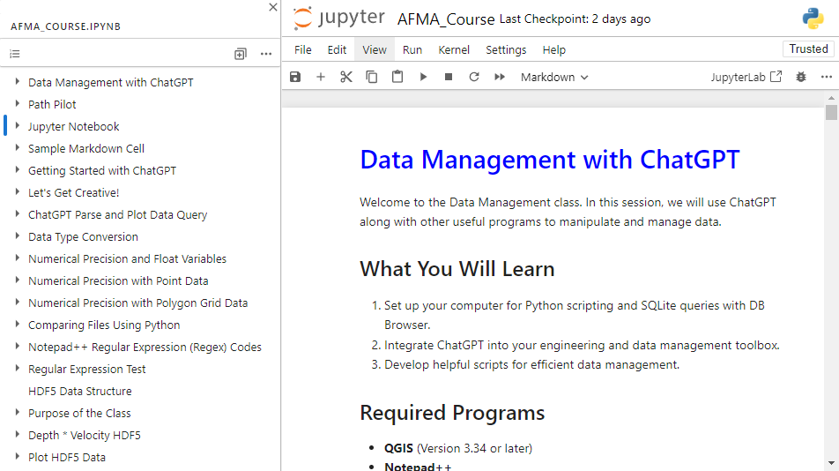
Workshop Notebook
Instructions on Markdown cells.
Code examples on code cells.
Add cells for your code.
Shift Enter to run cell.
If you double-click inside a Markdown cell. Run it to reset it.

Slide 9
OpenAI Account
Free Account
Mainly uses ChatGPT3.5.
Paste file samples directly.
Paid Account
ChatGPT4.0
Attach files and images.
Image to text.
DALL-E image generator.

Slide 10
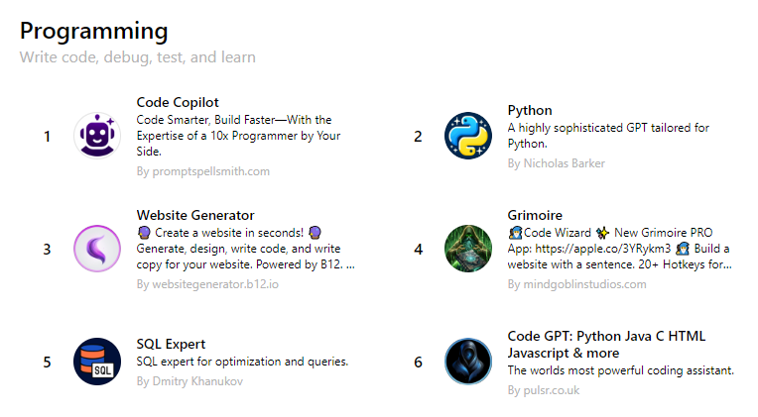
Specific GPTs
HEC Commander GPTs
HEC-RAS
HEC-HMS
Writing and Research
Scholar GPT
Write For Me
Video and PDF summarizer
Data Analyst

Slide 11
ChatGPT Memory
Initial use
Establish a memory.
Identify programs and versions.
Provide feedback on responses.
May not get the point.
Buggy code.
Use along with StackExchange or Reddit to find better solutions
Use over time
Fewer bad responses.
Learns your style and customs.
Limits responses to your program versions.
Adjusts feedback to your preferred language.
Snarky – funny – professional …

Slide 12
ChatGPT Errors
Vague questions
Knowledge cutoff
Simplify language
Break down communication to simple steps
Fact check and error check
Feed correct information back to ChatGPT.

Slide 13
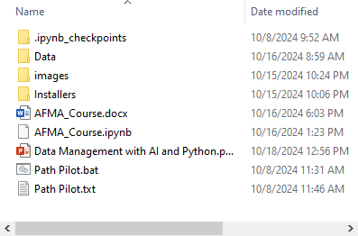
Workshop Package
Add package to an easy to access directory.
Be careful using OneDrive.
Start with the workbook.
Internet access is Guest wifi
Setup or log in to an OpenAI account

Slide 14
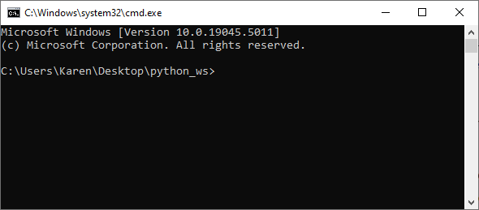
Path Pilot
Path Configuration: Automatically configures environment paths for QGIS, Python, and Jupyter, ensuring all tools are ready for use.
Automatic Detection: Detects and launches Jupyter Notebook from the working directory where the .bat file is located.
Simplified Workflow: Ensures that all required paths are correctly set up, eliminating manual configuration steps.

Slide 15
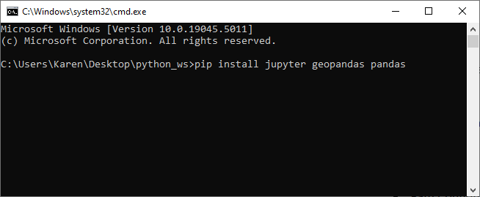
Path Pilot Terminal
Path Pilot uses cmd.exe to run commands.
It is a python terminal and a QGIS shell.
ChatGPT can provide commands and instructions for specific tasks.
We’ll mainly use it to install Python modules and run the Jupyter Notebook.

Slide 16
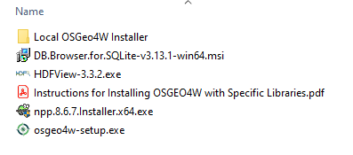
Workshop Installers
QGIS with local installer
Notepad++ installer
DB Browser
HDFView

Slide 17
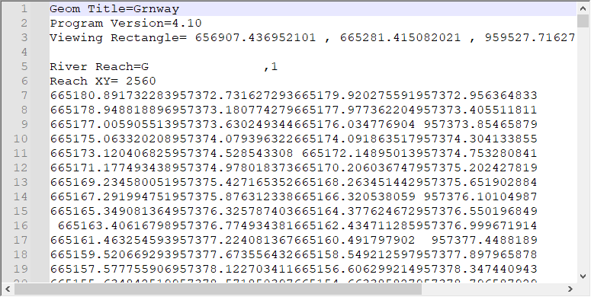

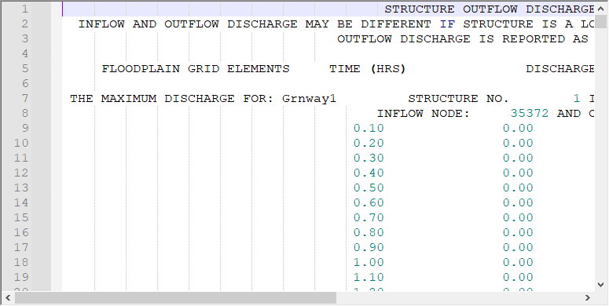
Data Samples
Text data
ASCII
UTF-8
UNIX
CSV

Slide 18
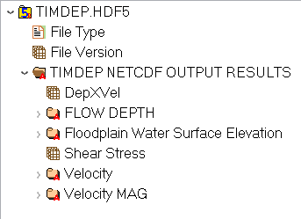
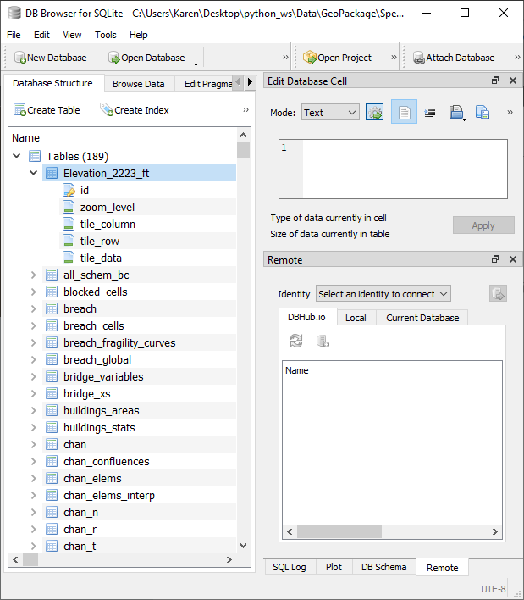
Data Samples
Binary Data
hdf5
gpkg
geodatabase

